Slide 1

Face Classification and Verification
11-785 Intro to Deep Learning – Recitation 6
Sumesh KS, Sarthak Bisht

Slide 2
The Classification Problem
How can I determine which of my emails are spam or not spam?
How can I identify positive and negative feedback from tons of customers review
This picture contains an image of what or who?
How did Face unlock know I am the owner!!!? (more on verification)
What digit have I written on this paper?

Slide 3
What is Classification
A supervised learning method where the model tries to predict the label/class for a given input data
In Context…
Given an image, figure out which class the image belongs to or rather the person in the image
Categories
Binary classification
Multi-class classification
An N way classification task, predicting from a fixed set of possible output classes

Slide 4
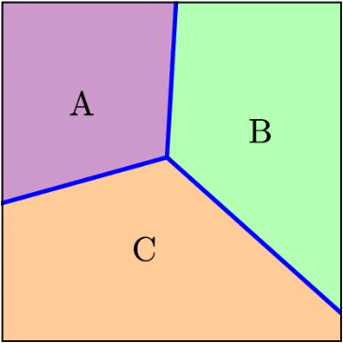
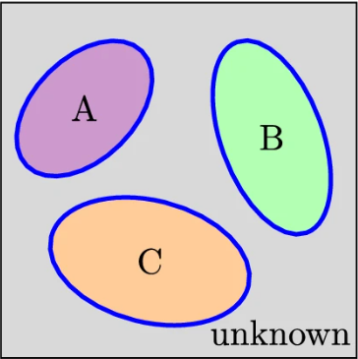
Tale of two classifications
Closed Set (Classification)
Open Set (Verification)
K known classes are present during training and testing
Learns decision boundaries that divide the feature space into K parts
K known classes during training but K known and U unknown classes present during inference
Tight decision boundary around the K classes are learned

Slide 5
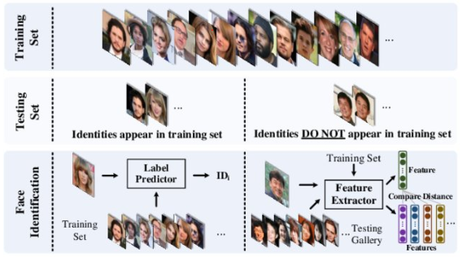
Closed vs open set classification
Closed Set | Open Set

Slide 6
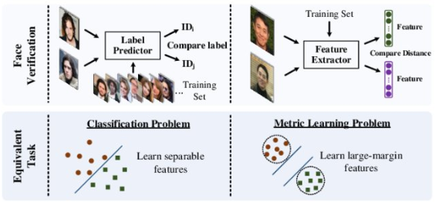
CLOSED vs Open SET VERIFICATION
Closed Set | Open Set

Slide 7
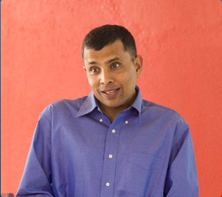
Problem Statement
Definition: This is a closed set problem, where the subjects in the test set have also been seen in the training set, although the precise pictures in the test set will not be in the training set.
Task: Identify the person in a picture; about 7001 unique image classes therefore, Multi-class classification
Feature extraction model
Classification linear layer
Softmax
Feature embedding
N-class Probability Logits
N-class probabilities

Slide 8
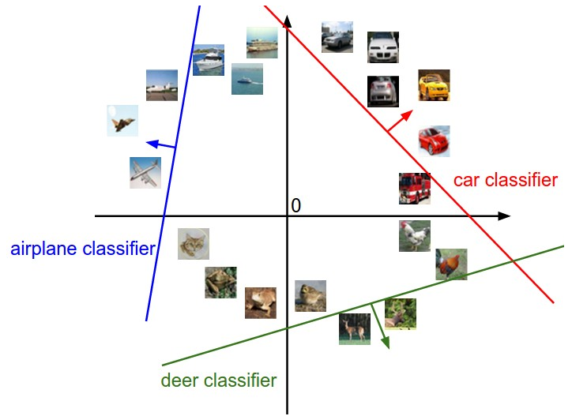
Training for Classification
Task: Identify the person in a picture; about 7001 unique image classes therefore, Multi-class classification
Feature extraction (CNNs)
Feature embeddings (creates important features which are separable)
Generate Logits (unnormalized probabilities)
Softmax (normalizes probabilities between 0 and 1)

Slide 9
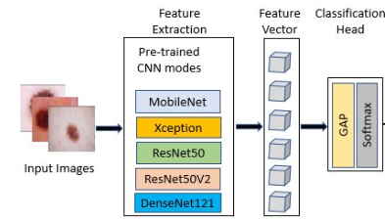
Training for Classification
Task: Identify the person in a picture; about 7001 unique image classes therefore, Multi-class classification
Prediction results
Class 1
EfficientNet
Class k

Slide 10
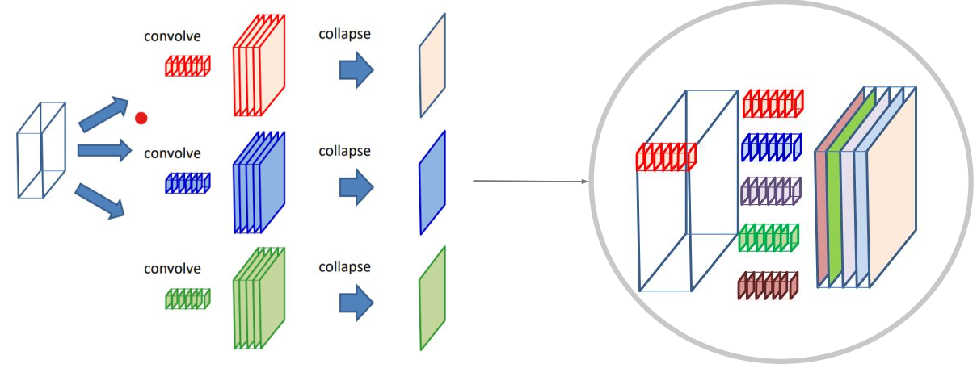
Conventional Convolution

Slide 11
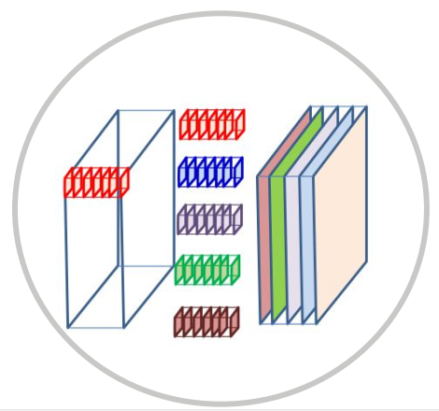
Conventional Convolution
Each filter (red, blue, ..) has N layers which correspond to the N number of input channels
Each layer of each filter scans a corresponding input channel to produce a convolved map
A filter with N layer will produce N convolved maps
The N convolved maps produced by a filter is added together to produce an output channel
Consequently, number of output channels determine the number of filters for convolving

Slide 12

Conventional Convolution
N input channels, M output channels
M independent filters with N layers each. Assuming each layer has a size K * K
Each filter will produce an output channel, therefore M output channels
Total Parameters: N * M * K²

Slide 13
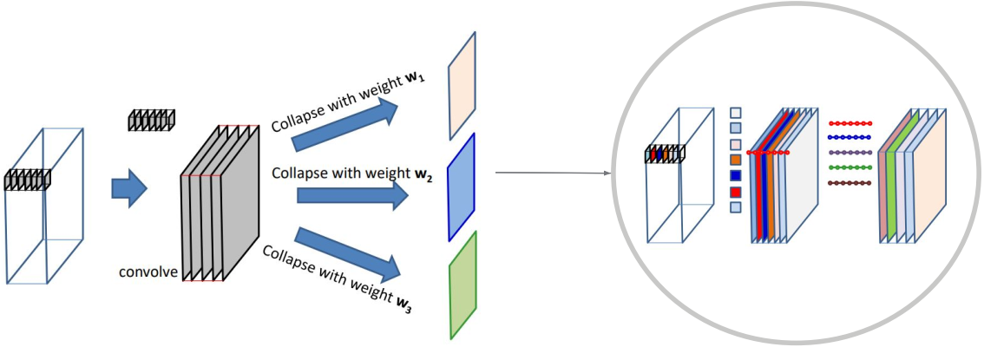
Depthwise separable convolution

Slide 14
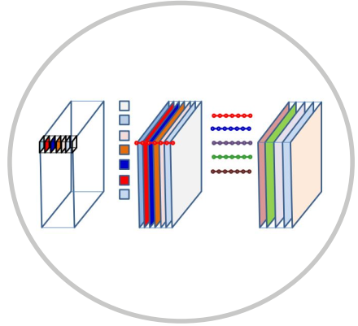
Depthwise separable convolution: Filtering
M input channels and N output channels in 2 stages:
Stage 1: Filtering
We need M independent KxK 2D filters, one per input channel
Each filter convolves with an input channel to produce intermediary output channels
# of input channels == # of output channels

Slide 15
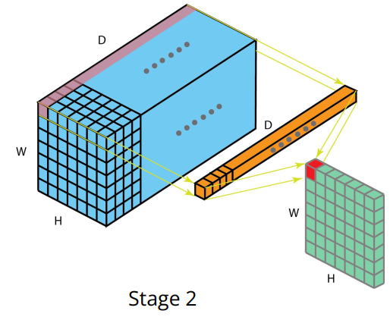
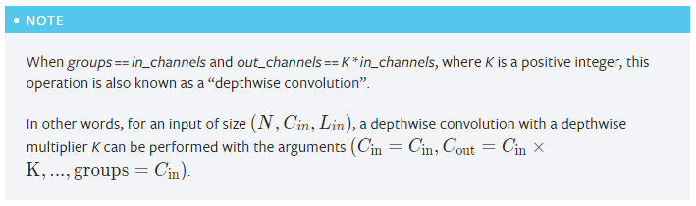
Depthwise separable convolution: Combining
Stage 2: Combining - Point wise convolution
N Mx1x1 filters
Each filter (Mx1x1) will be applied on the intermediary output channel a final output channel ( just like conventional convolution)
We would have a total of N output channels after all N filters have been applied
Total parameter: NM + MK²

Slide 16
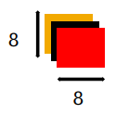


Depthwise separable vs regular: Parameter comparison
3x8x8 (in_channels = 3)
Regular Convolution
Depthwise convolution
3x5x5 kernel
Filtering:
1x5x5 kernel
1x5x5 kernel
1x5x5 kernel
Combining:
3x1x1 kernel
Regular Convolution
Depthwise convolution
Kernel: (3x5x5)
Total Parameters:
(8x8)*(3x5x5)*(256)
= 1,228,800
Filtering:
Kernel: 3*(1x5x5)
Parameters:
(8x8) * 3 * (1x5x5)
= 4,800
Combining:
Kernel: 256*(3x1x1)
Parameters:
(8x8) * 256 *(3x1x1)
= 49,152
Let:
out_channels = 256 Kernel size = 5
Total Parameters : 4,800 + 49,152 = 53,952

Slide 17
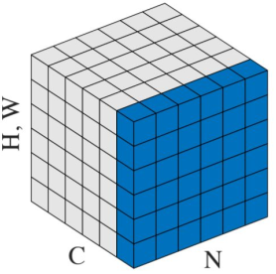
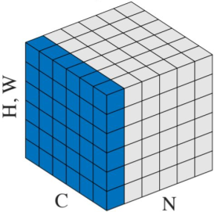


Basic TIPS: Normalization
Normalization
Batch Normalization
Batch Normalization allows us to use much higher learning rates and be less careful about initialization
It also acts as a regularizer, in some cases eliminating the need for drop out
BatchNorm Paper
Layer Normalization
Each neuron has its own adaptive bias and gain
Layer normalization performs same computation at training and testing
LayerNorm Paper
Good to explore: Group Normalization & Instance Normalization

Slide 18
Basic TipS: Label SMoothing
Problem Statement
Label Smoothing
Deep neural network models often find themselves falling prey to Overfitting and Over-confidence
Overconfidence is when the model predicts a very high probability for input making it rigid (Hard label) and less generalizing; A good model should give room for uncertainty for other classes
For example, if k = 3 classes, with a label belonging to the first class, we will get an output probability result of [0.9999, 0, 0]; this is a poorly calibrated model
Solves the problem of over-confidence by introducing output distribution regularization to the network
Applies weighted average across the output labels to “smoothen” or soften them
Increases robustness of model and improves model performance

Slide 19
Basic Tips: Label Smoothing
Label Smoothing:
y_ls = (1 - α) * y_hot + (α / K)
Where:
y_ls = smoothed labels; y_hot = Original labels; α = smoothing factor; K = classes
Example: Suppose we have K = 3 classes, and our label belongs to the 1st class. Logit Vector z = [a, b, c]; Label vector y = [1, 0, 0] (one-hot encoded)
Without Label Smoothing
With Label Smoothing (α = 0.1)
Gradient of Loss = softmax(z) – y
Our model will make a ≫ b and a ≫ c
z = [10, 0, 0]
softmax(z) = [0.9999, 0, 0]
y_ls = [0.9333, 0.0333, 0.0333]
Gradient of Loss = softmax(z) – y_ls
z = [3.3332, 0, 0]
softmax(z) = [0.9333, 0.0333, 0.0333]
https://arxiv.org/pdf/1812.01187.pdf
https://arxiv.org/abs/1812.01187
https://github.com/ankandrew/online-label-smoothing-pt

Slide 20
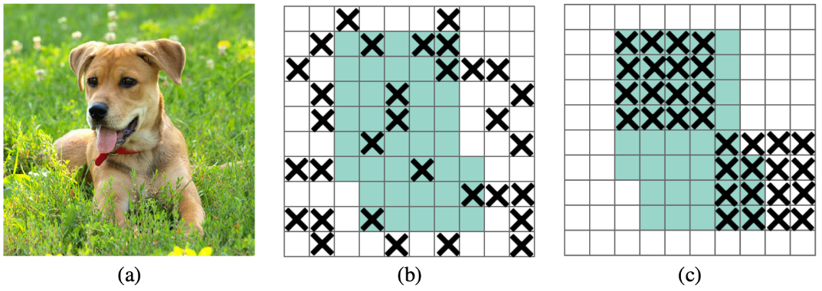
Basic Tips: DropBlock
DropBlock
Dropout usually works better with Fully Connected Networks
Dropout has not proven to be useful in CNNs because of the spatial correlation between the activation outputs
DropBlock is a regularization technique that has proven to be useful for CNNs
It is a structured form of dropout that drops contiguous regions and not just random pixels
Paper: https://arxiv.org/pdf/1810.12890.pdf
Pytorch docs: https://pytorch.org/vision/main/generated/torchvision.ops.drop_block2d.html

Slide 21
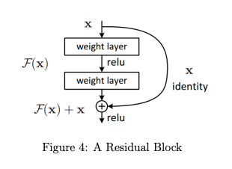
Residual networks
Deep neural networks suffer from vanishing and exploding gradients
Residual networks (resnets) enable us to train very deep neural networks
Resnets consist of residual blocks- set of layers that are connected to each other, and the input of the first layer is added to the output of the last layer in the block.
This is a residual connection, allowing deeper networks to be built and trained efficiently.
Popular architectures that make use of residual blocks: MobilNet, ResNet and ConvNext etc. Please read their respective research papers!!

Slide 22
Homework 2 Part 2 Overview
Objective: To solve an image-based face classification problem using a CNN
Scenario at hand: Recognizing and verifying faces in images.
Motivation: Pictures of the faces have indeterminacy of position and CNN’s are position invariant
Problem Type: A closed set problem, where the subjects in the test set have also been seen in the training set, although the precise pictures in the test set will not be in the training set.
Requirement: The embeddings for the subjects in our vocabulary be linearly separable from each other

Slide 23
What to implement
Goal: To implement a face classifier that can extract feature vectors from face images.
Two main parts: Feature Extractor and Classification Layer
Learning facial features (e.g., skin tone, hair color, nose size, etc.) from an image of a person’s face and represent them as a fixed-length feature vector called face embedding.
Steps:
Implement architectures consisting of multiple convolutional layers outputting a feature vector.
The vector is passed through a linear layer followed by Softmax to classify it among ’N’ categories.
Use cross-entropy loss for optimization.

Slide 24
Dataset
Subset of the VGGFace2 dataset.
Images are downloaded from Google Image Search
Large variations in pose, age, illumination, ethnicity, and profession
7,001 identities.
Class-balanced, so each class has the equal number of training images, and all the images are resized to 224 x 224 pixels.
Aim: Learn to classify images with the correct face identity from 7001 identities.

Slide 25
Dataset and Dataloader class
Use the ImageFolder class from the torchvision library and passing it the path to the training and validation dataset
ImageFolder class will automatically infer the labels and make a dataset object, which we can then pass on to the dataloader.
Make sure to pass the image transforms to the dataset class for doing data augmentation.
The images in subfolders of classification data are arranged in a way that is compatible with this dataset class

Slide 26
How do we train CNN’s?
Conducting face classification = multi-class classification
Input to system = face’s image, model’s output = predicted ID of the face
Goal: Train your model on data to produce “good” face embeddings.
Optimize these embeddings to predict the face IDs from the images. The resulting embeddings will encode a lot of discriminative facial features, just as desired. This suggests an N-class classification task.
A typical multi-class classifier conforms to the following architecture: Classic multi-class classifier = feature extractor(CNN) + classifier(FC)

Slide 27
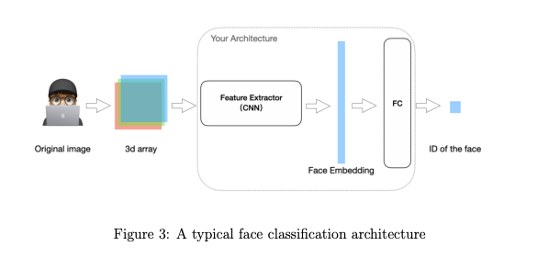
How do we train CNN’s?
The input will be several images
Network consists of several (convolutional) layers for feature extraction.
The output of the last feature extraction layers is the face embedding.
Then pass this face embedding through a linear layer, followed by a Softmax, to classify the image among the N people.
Use cross-entropy loss to optimize your network to predict the correct person for every training image (the ground truth will be provided in the training data)
Use validation set for fine-tuning your model.

Slide 28
Starter Notebook Overview
Download Data from Kaggle (Add your Kaggle key and username)
Set your Configurations
Potentially 100 for final submission. Start early!!!
Batch_size
Learning rate
Classification Dataset: Transforms/augmentation methods using torchvision
Data visualization : Sanity check
Very Simple Network (for Mandatory Early Submission): 4-layer CNN
Resnets : MobilNet, ResNet and ConvNext, etc
Setup everything for training: Criterion, Optimizer, Scheduler

Slide 29
Questions?

